Slide 1
BUtter knife
Mohammad Kazim (13-4093)
Muhammad Iqbal (14-4270)
Mohammad Abdullah (14-4174)

Slide 2
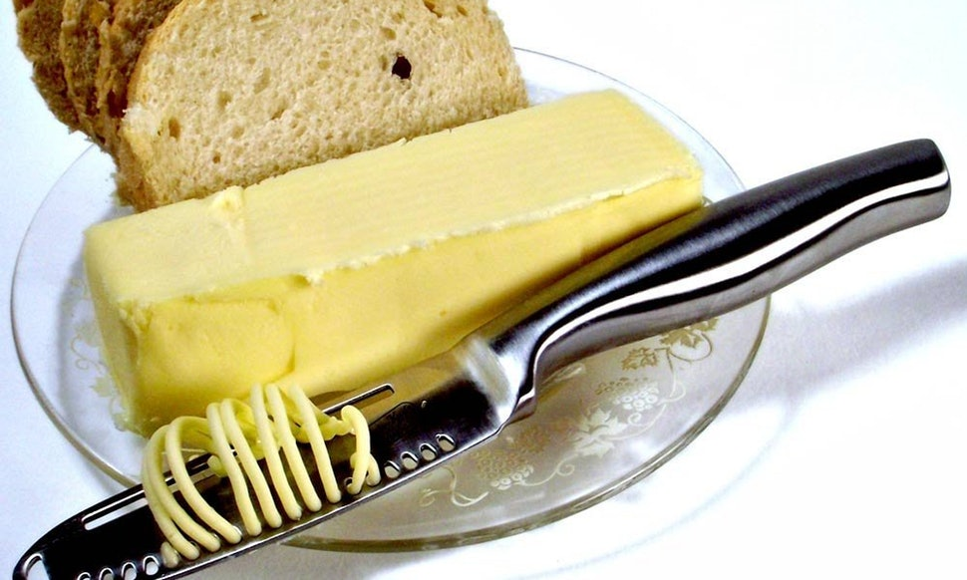
You might be thinking of this..
Notes:
Butterknife is a light weight library to inject views into Android components. It uses annotation processing.

Slide 3
What is Butter knife?
Android Butter Knife is an open source view “injection” library for Android
Notes:
Butterknife is a light weight library to inject views into Android components. It uses annotation processing. Android Butter Knife is an open source view “injection” library for Android

Slide 4
Why ButterKnife?
The goal is to help developers write better code, and it does so by trying to reduce the code.
It makes the code more presentable and understandable.
Notes:
The goal of this library is to help developers write better code, and it does so by trying to reduce the code used in the onCreate method on an Activity class and in onCreateView on Fragment s.

Slide 5
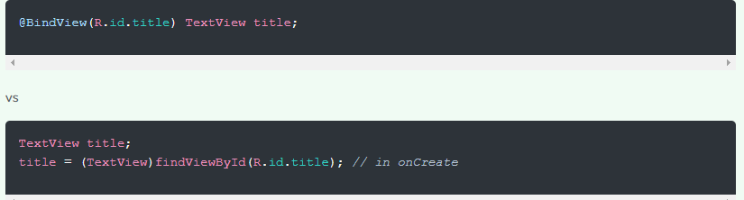
Butterknife vs !(Butterknife)
Notes:
It's just a convenience thing. ButterKnife only uses one line to populate a View field, whereas normally you'd have to use two. Multiply that by all of your View fields, and it starts to add up!
v and is essentially used to save typing repetitive lines of code like findViewById(R.id.view) when dealing with views, thus making our code look a lot cleaner.
Android Butter Knife helps you create cleaner and tidier code, handling a lot of the ugly boilerplate code that Android has become infamous for.

Slide 6
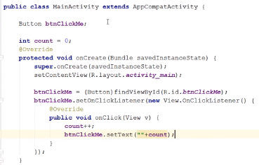
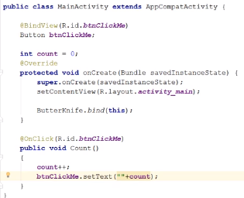
Butterknife vs !(Butterknife)

Slide 7
how does butterknife work?
Notes:
Butterknife uses annotation processing to generated modified Java classes based on your annotations. Annotation processing is a tool build in javac for scanning and processing annotations at compile time.
You can define custom annotations and a custom processor to handle them. These annotations are scanned and processed at compile time. The annotation processor does not change the exiting input class but it generates a new Java class. This generated Java code is compiled again as a regular Java class.
The Butterknife annotation processor scans all Java classes looking for the Butterknife annotations. If a class contains these annotations, it generates a new class based on the <original_class>__ViewBinding schema.

Slide 8
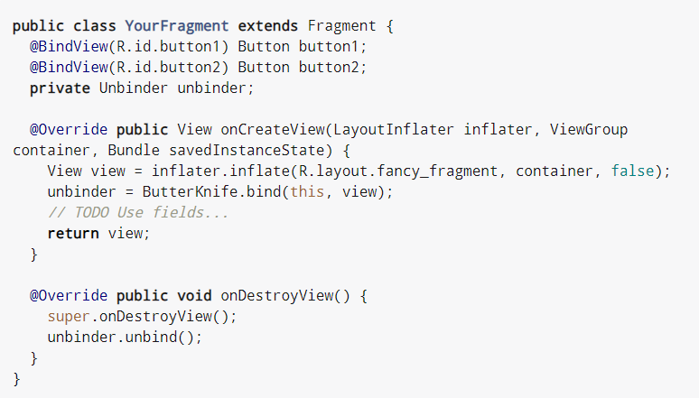
BInD and unbind

Slide 9
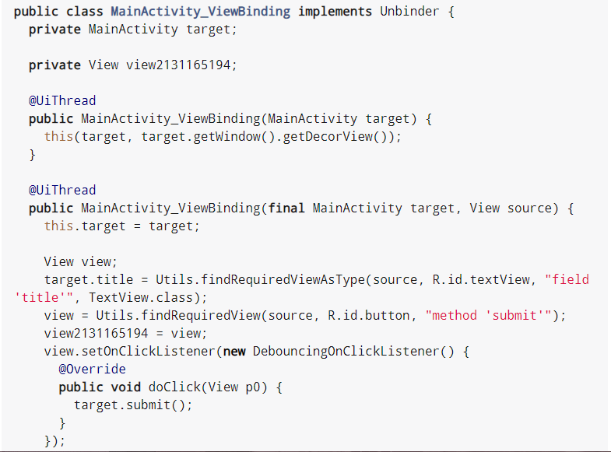
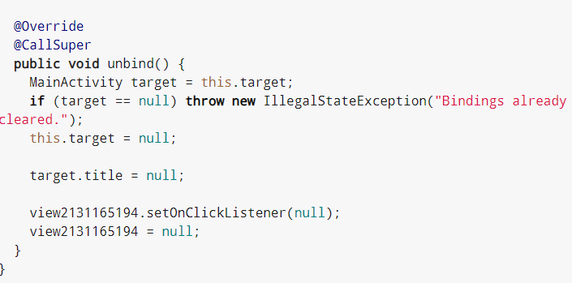
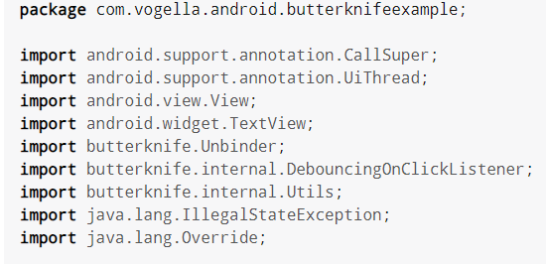
Implements Unbinder

Slide 10
how to add butterknife in your project!!
Step 1: Add below dependency in your app level build.gradle file:
def BUTTER_KNIFE_VERSION="8.5.1" //current version of butterknifedependencies
{
compile "com.jakewharton:butterknife:$BUTTER_KNIFE_VERSION" annotationProcessor "com.jakewharton:butterknife-
compiler:$BUTTER_KNIFE_VERSION“
}

Slide 11
Continued..
Step 2: Add below buildscript in your project level build.gradle file:
buildscript { repositories { mavenCentral() } dependencies { classpath ‘com.jakewharton:butterknife-gradle-plugin:8.5.1’}
}
Step 3: Then apply plugin in your app level build.gradle using below lines:
apply plugin: ‘com.jakewharton.butterknife’

Slide 12
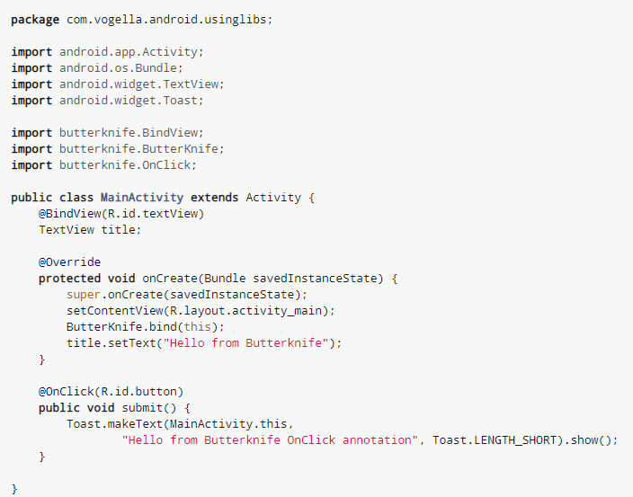
Overide BindView, OnClick and ButterKnife.bind methods to get the views injected.

Slide 13
References:
https://www.youtube.com/watch?v=C9023cw9slE
https://hackernoon.com/android-butterknife-vs-data-binding-fffceb77ed88
http://jakewharton.github.io/butterknife/
http://www.vogella.com/tutorials/AndroidButterknife/article.html

Slide 14
Thank YOu!!

Slide 15
You might be thinking of this..
Notes:
Butterknife is a light weight library to inject views into Android components. It uses annotation processing.

